Slide 1





Slide 2

INTRODUCTION AND
IMPORTANCE OF FRAUD DETECTION
Fraud detection involves identifying unusual patterns or activities in transactions to prevent financial losses with the rise of digital payments.
detecting fraudulent activities is crucial to maintaining trust, security, and the integrity of financial systems.
Fraud detection protects businesses and individuals from financial harm, preserves customer trust, and ensures compliance with regulations.
By identifying fraud early, organizations can reduce losses and safeguard their reputation.

Slide 3

Project Overview :-
Enabling the company to improve security,
Reduce financial losses, and
Gain insights into factors contributing to transaction fraud.
Aims to enhance the accuracy of detecting fraud in mobile financial transactions.
By leveraging machine learning, the project seeks to predict fraudulent transactions with high precision.
The goal is to develop a robust machine learning model to accurately identify fraudulent transactions in real-time ,

Slide 4
Amount: Transaction value (local currency).
Sender Details:
nameOrig: Customer initiating the transaction.
oldbalanceOrg: Balance before transaction.
newbalanceOrig: Balance after transaction.
Recipient Details:
nameDest: Customer receiving the transaction.
oldbalanceDest: Balance before transaction (missing for merchants).
newbalanceDest: Balance after transaction (missing for merchants).
isFraud(Fraud Indicator): Fraudulent activities involve account takeovers, fund transfers, and cash-out attempts.
Dataset Structure
Step (Time Unit ) : 1 step equals 1 hour (Range: 1–95).
Transaction Types:
CASH-IN: Depositing cash into an account.
CASH-OUT: Withdrawing cash from an account.
DEBIT : Decrease in account balance (withdrawal/expense).
PAYMENT: Transfer of funds for goods/services.
TRANSFER: Moving money between accounts.

Slide 5
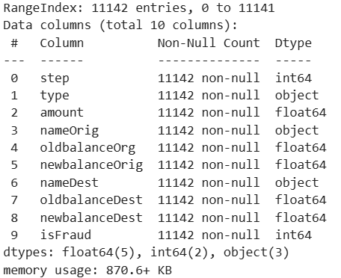
Dataset Details
11,142 – Rows 10 - Columns
NUMERICAL
COLUMNS
step
CATEGORICAL COLUMNS
type
amount
oldbalanceOrg
newbalanceOrig
oldbalanceDest
newbalanceDest
nameOrig
nameDest
isFraud
No missing values in the dataset. Every row in every column has valid data.

Slide 6

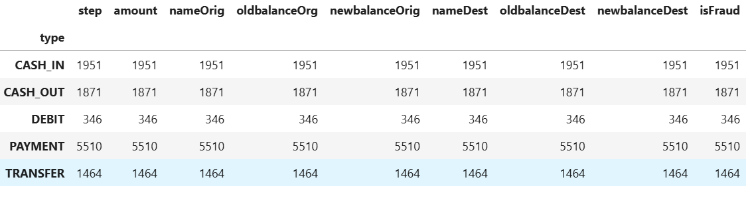

TYPES OF TRASACTIONS AND NUMBER OF TRASACTION HAPPENING
Data has been grouped based on the type column, and the count of non-null values in each column has been calculated. It helps to see how many transactions there are for each type.

Slide 7

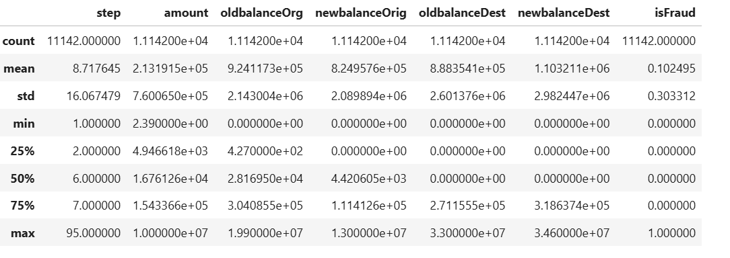
BASIC STATISTICS AND INSIGHTS
amount:
mean- average transaction amount of- 213K.
std - 7.6 million , so much difference in transactions amount.
Min-smallest transaction amount was 239K
25%- 25% of transactions are below 494K
75% - are below 1.54 million.
Maximum – 10 million
oldbalanceOrg –
mean- average balance is 9.24 lakhs in account holders.
Std - 2.14 million, differences in customers bal. before the transaction.
25%- 25% of customers had bal. below 427 before the transaction
50%-before transactions is 28,169.50 75%- 75% of customers had balances below 304,085.50
Max- highest Balance before the transaction was 19.9 million.
newbalanceOrig-
median value, after transaction, remaining balance will be very less or Zero
isFraud(Fraud Detection)-
10.2% transactions are fraudulent(Fraud)
50%- median is 0, means mostly transactions are not fraudulent.
max – max value is 1, representing fraudulent transactions.
oldbalanceDest & newbalanceDest (RECIEVER'S BALANCE)-
maximum balance is 3.46 crore

Slide 8
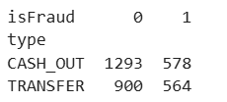
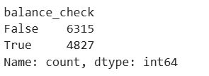
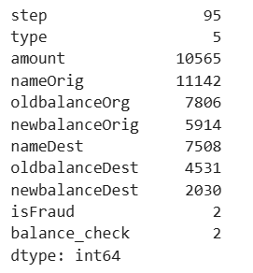
balance check
Unique values
Mostly fraud transitions type
Rows (type):
CASH_OUT : money was withdrawn
Non- fraudulent - 1,293
Fraudulent- 578
TRANSFER : money was transferred.
Non- fraudulent - 900
Fraudulent- 564
Balance:
Mismatched transitions - 6315
Matched Transitions - 4827

Slide 9

Understand the Data
We look at the data to see what’s inside – things like transaction amounts, sender and receiver details, and account balances. This helps us know how the data is organized and what we are working with.
Spot Patterns
We search for trends or patterns in the transactions, like how much money is usually sent or withdrawn, and at what times. This helps us see what normal behavior looks like.
Exploratory Data Analysis (EDA)
Identify Outliers
We check for anything unusual – like very large transactions or accounts with strange activity. These could be red flags for fraud.
Prepare the Data for Analysis
We clean the data by fixing errors or filling in missing information. This ensures our analysis is accurate and ready to identify fraudulent transactions.

Slide 10
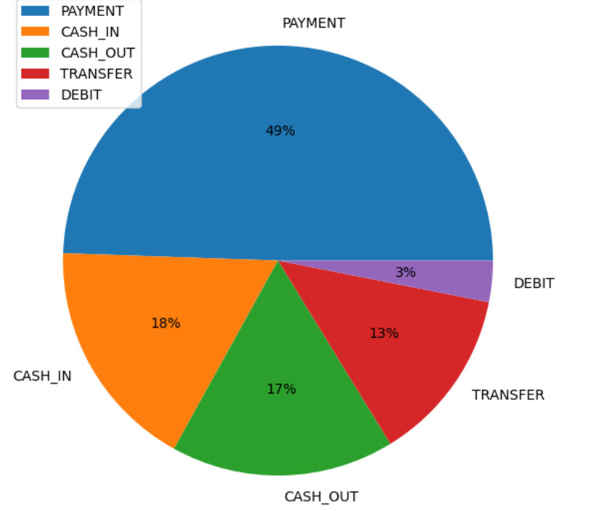
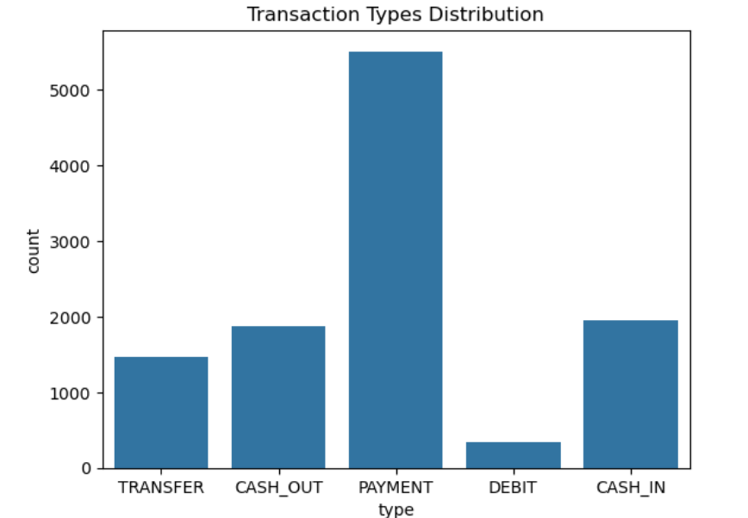
Transactions type :- Pie Chart
PAYMENT: Largest share at 49%, indicating most transactions are payments.
CASH_IN: Accounts for 18%, representing money deposits.
CASH_OUT: Makes up 17%, involving withdrawals.
TRANSFER: Covers 13%, showing money transfers.
DEBIT: Smallest share at 3%, indicating infrequent usage.
Transactions type :- Bar Chart
x axis - it shows the transactions types and also express the unique value which represents the different mode of transactions
y axis - it shows the count of type of transactions in the dataset.
Insights-
dominant transaction type - Payment, this is the frequently type of transaction.
it means in this dataset holders are accounts doing Payments frequently
Other type - CASH_OUT and CASH_IN is the most common transaction type.
TRANSFER is moderate - DEBIT is the rarest or low transaction type

Slide 11

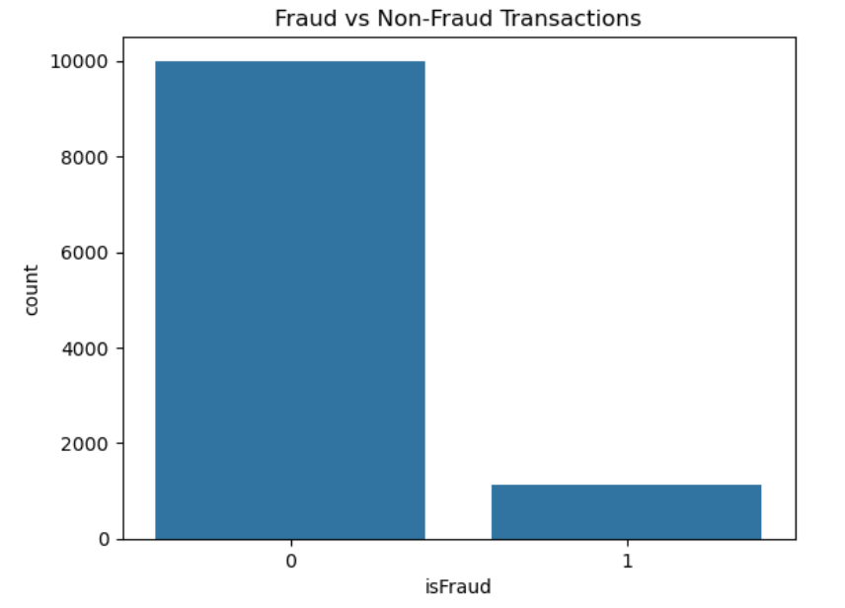
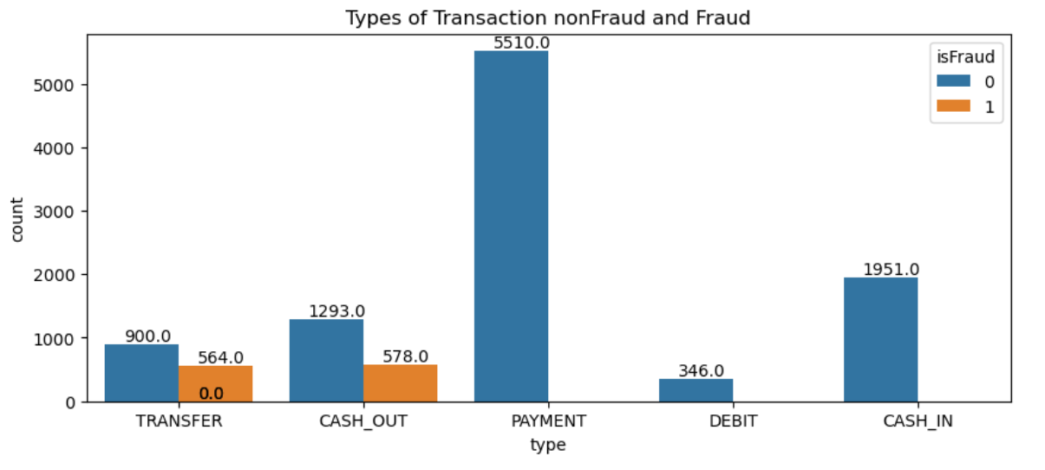
Bar chart compares - fraudulent (isFraud = 1) and non-fraudulent (isFraud = 0) transactions across different transaction types:
TRANSFER Transactions:-
Fraudulent: 564 cases.
Non-Fraudulent: 900 cases.
- Observation: Fraud is relatively high in transfer transactions.
CASH_OUT Transactions:-
Fraudulent: 578 cases.
Non-Fraudulent: 1,293 cases.
- Observation: Similar to transfer, cash-out transactions also have a notable number of frauds.
- 0: Non-Fraudulent Transaction -Having around 10,000 transactions
- 1: Fraudulent Transaction -Having around 1,000 transactions

Slide 12
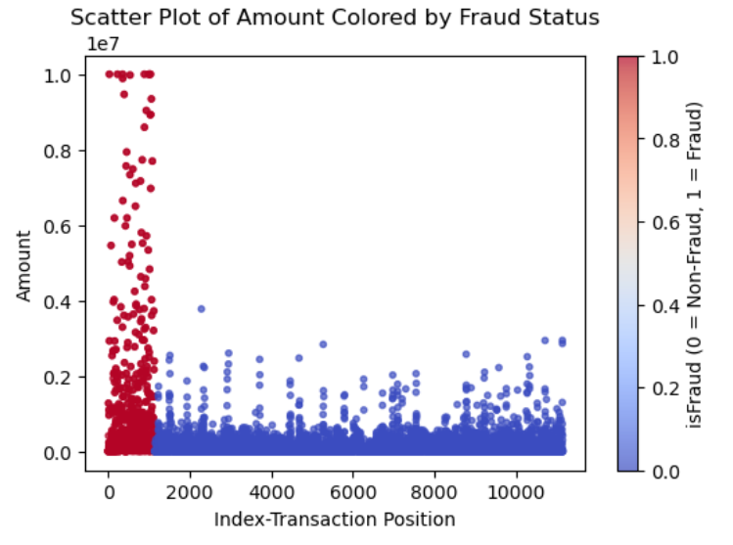
Significance of Transaction Amount in Fraud Detection
Important Findings -
Scatter Plot - of Amount Colored by Fraud Status .
Here we are - Analyze High-Value Transactions Separately. Through this and we will - Check the Amount, Transaction Type, and Fraud status.
Here we sort - the Top 10 Fraudulent Transactions by Amount and description separately
1) Scatter Plot - of Amount Colored by Fraud Status
x-axis(index):
it is showing that which transaction is placed at which position in the data set.
the index initially started at 0 (zero) which has grown to 10,000 .
y-axis (amount):
it is showing transaction amount.
All the dots is showing transaction amount's size.
- The amounts are small which closer to 0, and the higher you go, the larger the amount.

Slide 13

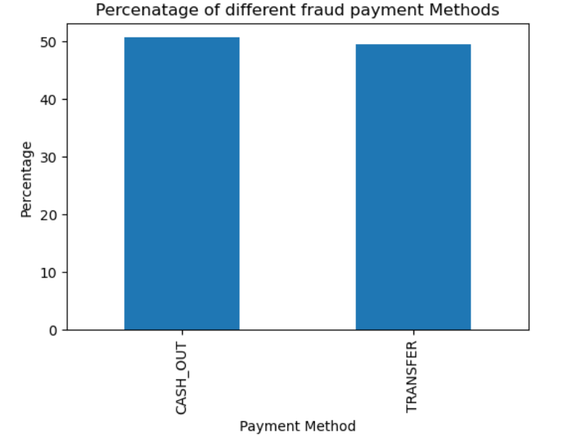

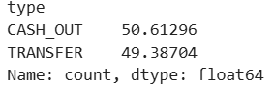
1) a. Visualization of Fraud Transactions- CASH_OUT and TRANSFER - Bar chart
CASH_OUT and TRANSFER are the primary methods through which fraudulent transactions occur.
2. Almost equal split between CASH_OUT and TRANSFER frauds means that fraudsters use both methods in similar ways. This could be because both methods might have similar security gaps or are equally easy for fraudsters to misuse.

Slide 14
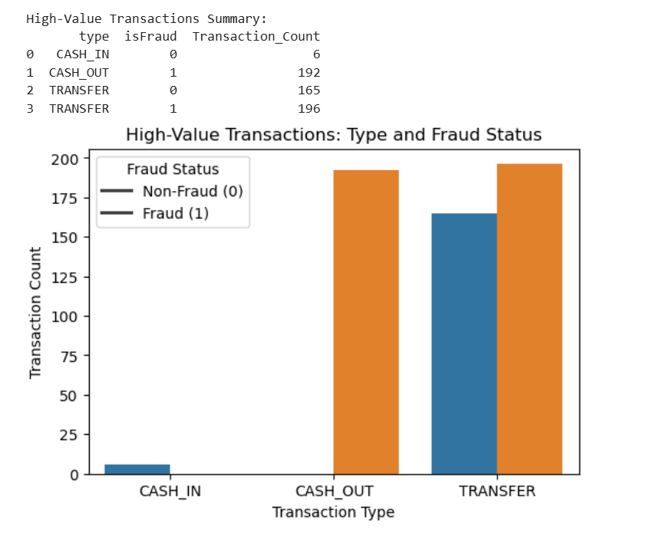
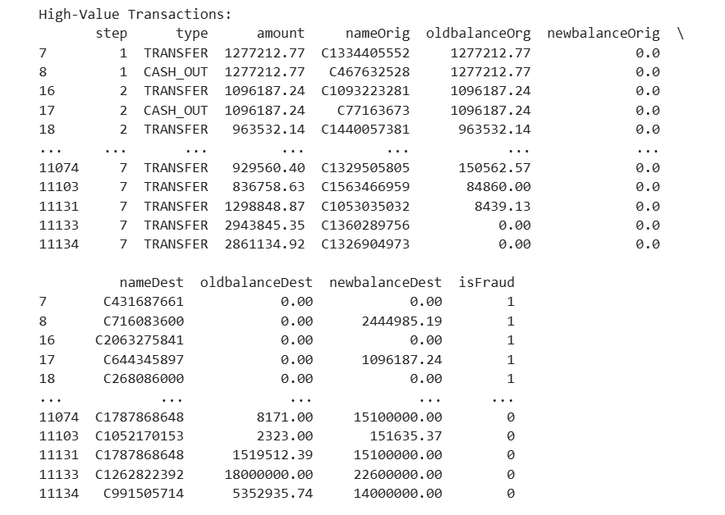
2) Here we are analyse high-value transactions separately. Through this and we will check the amount, transaction type, and fraud status
Blue Bar
Orange Bar
X-Axis (Transaction Type):- showing-type of transactions are(CASH_IN, CASH_OUT, TRANSFER).
Y-Axis (Transaction Count):- showing transaction count, i.e. how many times each transaction type has occurred, along with the fraud status.

Slide 15
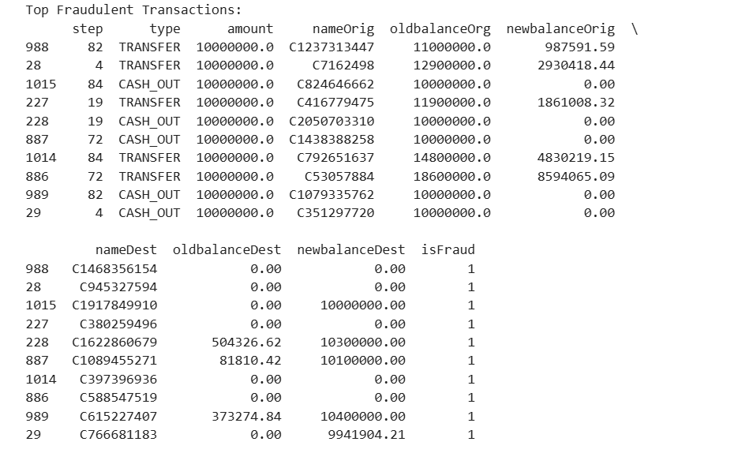
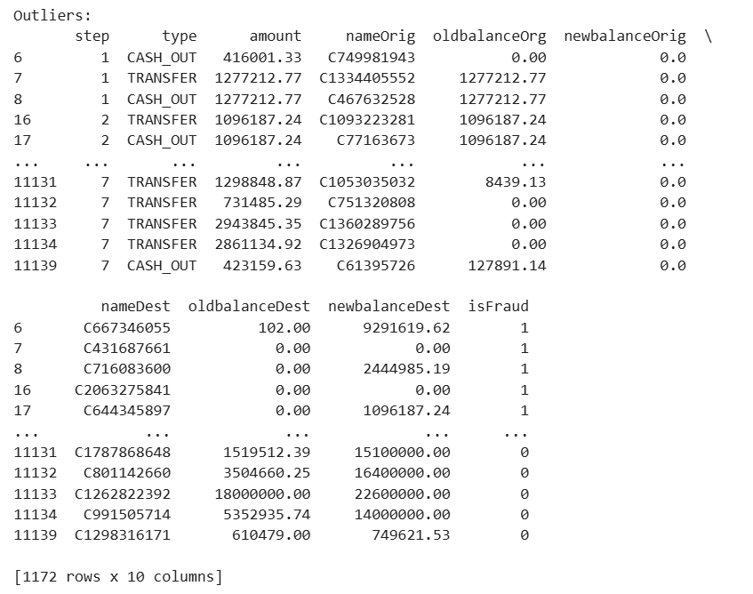
3) Here we sort the top 10 fraudulent transactions by amount and description separately:
top 10 fraudulent transactions have amount of - 10,000,000 involved in fraud.
amount-
transactions involve large sums of money, which is why they are flagged as outliers.
Unusual Transactions:
Some transactions look strange because the destination account has no initial balance or does not show the money received, which raises red flags.
1,172 rows -these are all the unusual transactions identified.
nameOrig and nameDest - help in - identify suspicious accounts involved in fraudulent activities
top fraudulent transactions include both TRANSFER and CASH_OUT

Slide 16
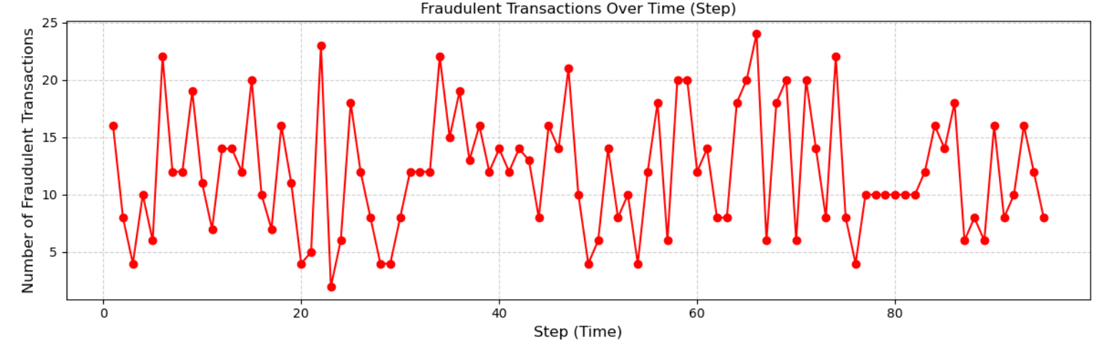

Fraudulent transactions over time (steps)
Fluctuations: frequency of fraud fluctuates significantly over time, with periods of high activity (spikes) and periods of lower activity (dips) .
Insight :-
Resulting plot shows the trend of fraudulent transactions over time.
we can identify periods with spikes in fraudulent activity, which could indicate patterns or anomalies worth further investigation

Slide 17

Observations with balance errors in the account
Sender’s Balance Errors: (oldbalanceOrg)
63% of transactions have errors in the sender's account balance.
This means in many cases, the sender’s balance after the transaction does not correctly reflect the amount deducted.
Receiver’s Balance Errors: (newbalanceDest)
100% of transactions have errors in the receiver's account balance.
This means for all transactions, the balance of the account receiving the money does not correctly reflect the amount added.
Mistakes in how account balances are updated after transactions.
- For the sender, these mistakes happen in 63% of cases, and
- For the receiver, it happens every time. This is a big red flag and needs to be investigated further.

Slide 18
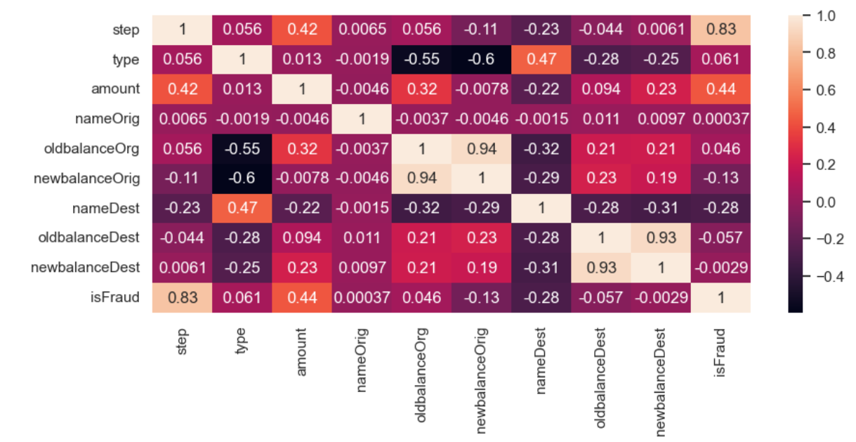
Correlations Heatmap
heatmap that shows the relationships (correlations) between different features (columns) in the dataset.
Step and isFraud (0.83):- high correlation - that fraud tends to happen more at specific times.
Amount and isFraud (0.44): moderate correlation - Higher transaction amounts might be more likely to be flagged as fraud.
Type and nameDest (0.47):
moderate correlation- might suggest that certain types of transactions are associated with specific accounts.
oldbalanceOrg and nameDest
(-0.32): Negative Correlations
oldbalanceOrg and newbalanceOrig (0.94): Very strong positive correlation- This makes sense because the sender's balance changes predictably based on the transaction.
oldbalanceDest and newbalanceDest (0.93):
strong positive correlation

Slide 19

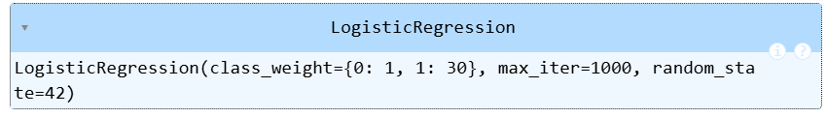
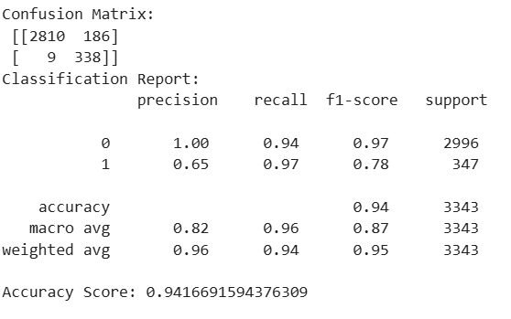
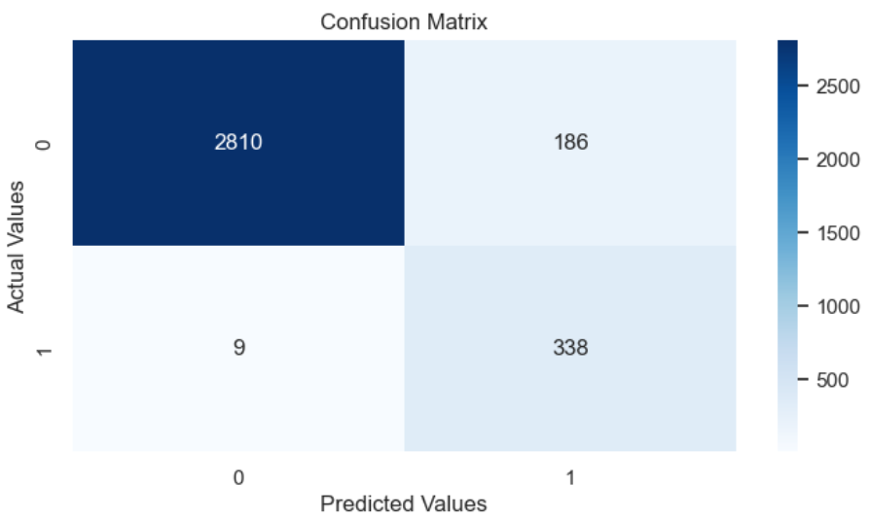
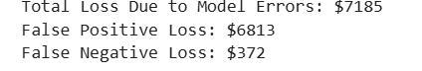

LOGISTIC REGRESSION
Accuracy (0.94): The model correctly classifies 94% of the total transactions.
F1- score - 0 non fraud- 0.97
- 1 fraud - 0.78
What are the potential losses due to model errors ?

Slide 20
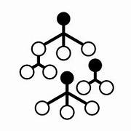
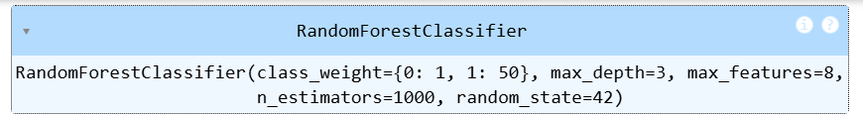
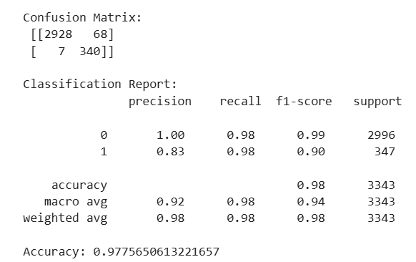
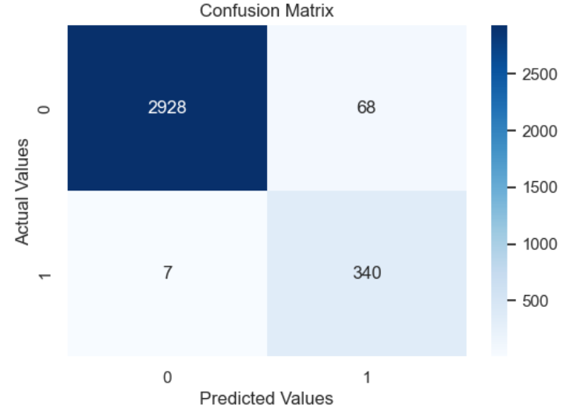
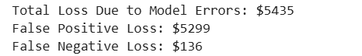
Accuracy: 0.94 (94% of predictions were correct overall).
Random Forest Classifier
Accuracy: 0.94 (94% of predictions were correct overall).
F1-Score (A balance between precision and recall):
0: 0.97 (Good performance for class 0).
1: 0.78 (Moderate performance for class 1).
What are the potential losses due to model errors ?

Slide 21
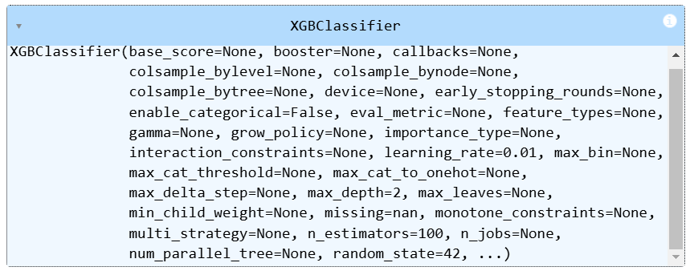
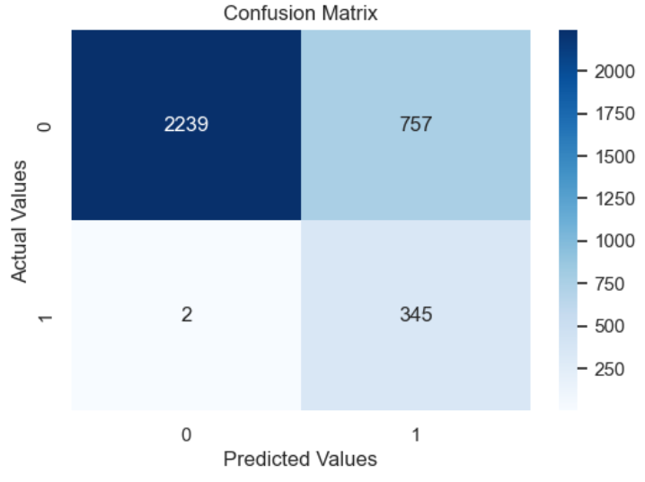
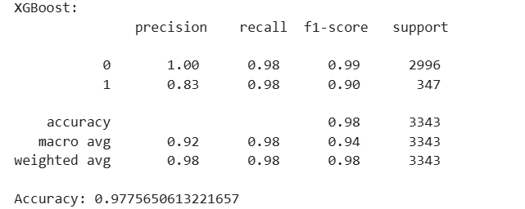
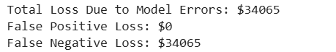
XG Booster Classifier
Accuracy: 0.98 (98% of predictions were correct overall).
What are the potential losses due to model errors ?
F1- score - 0 non fraud- 0.99
- 1 fraud - 0.90

Slide 22

Conclusion -
Best Model: Random Forest
Reasons:
High Accuracy and Recall: Random Forest identifies almost all true positives while keeping false positives relatively low.
Lowest Total Loss: $5,435 is the lowest financial loss among the three models.
Balanced Performance: It has a strong balance of precision and recall, leading to fewer mistakes overall.
Why Not XGBoost?
XGBoost has excellent metrics but a massive false negative loss of $34,065. It misses many actual class 1 cases, which is costly.
Why Not Logistic Regression?
Logistic Regression has decent metrics but misses more actual class 1 cases (lower recall), leading to a higher total loss of $7,185 compared to Random Forest.
Random Forest is the best because it balances great performance with the lowest financial cost due to errors!

Slide 23
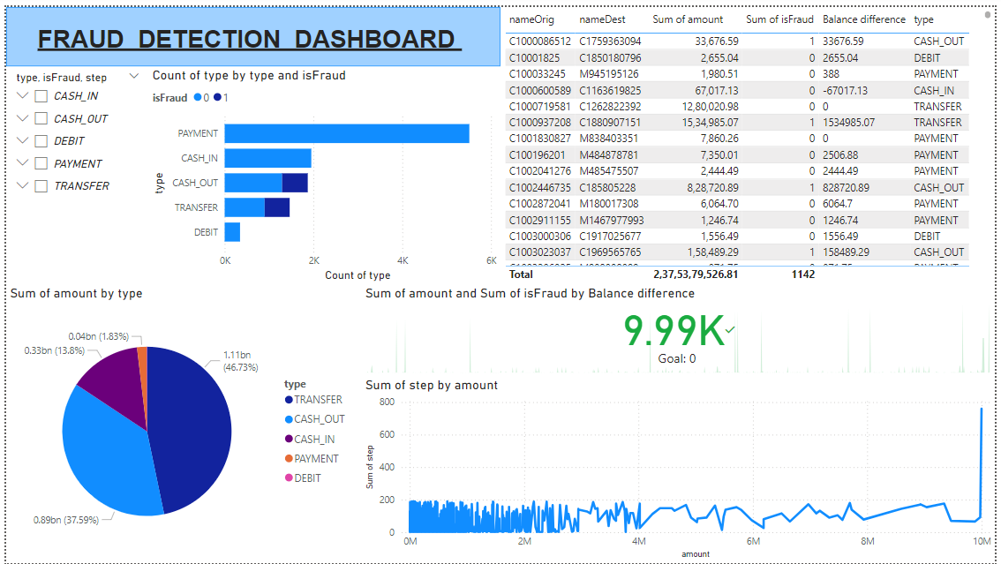
POWER-Bi DASHBOARD

Slide 24


